Slide 1
Prediction of H-1B cases
Project created by Aisulu Omar

Slide 2
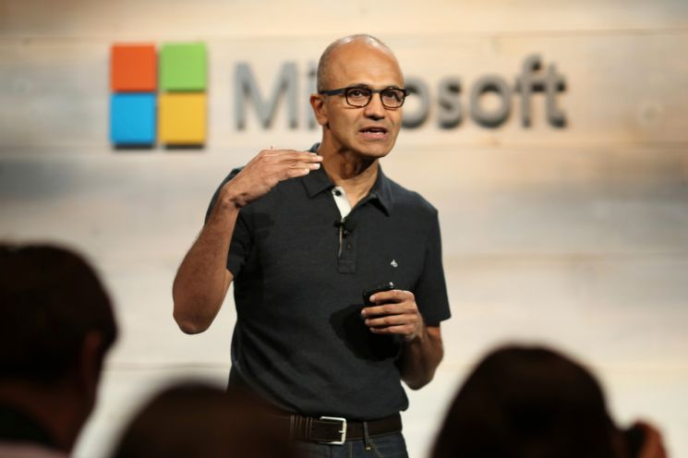
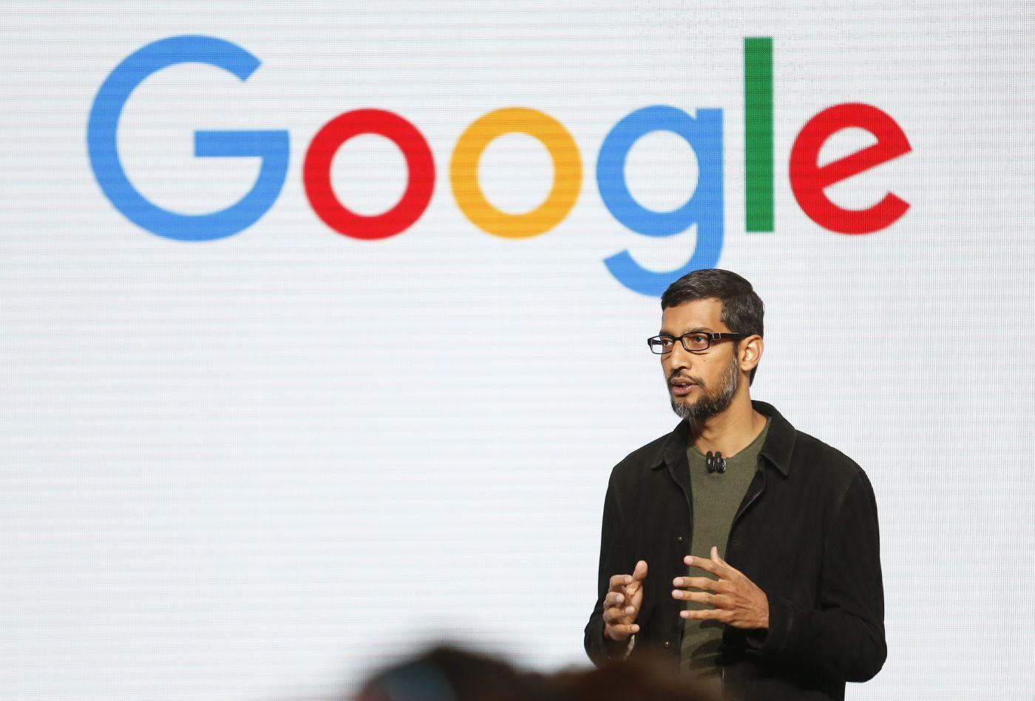

What is H-1B?
Do you know those people?
All of them moved to US on H-1B visa. The H-1B visa program is open to foreign workers who hold a bachelor’s degree or higher, and work in a field where employers looking for best talents in the world.
Notes:
The H-1B visa program is open to foreign workers who hold a bachelor’s degree or higher, and work in a field where employers struggle to hire American workers. The program is popular among large tech companies, who collectively employ thousands of workers on H-1B visas.

Slide 3
Why I am doing this project?
The visa procces is extremely long, unclear and expensive.
I moved to US three years ago on H-1B visa and I was lucky enough to get it. But was it luck? how does the system even work.
Can I predict the case status of the visa?
Notes:
No. She wrote an article in NYT, describing her experience and there are thousands of similar experince.
She wrote an article in NYT, describing her experience and there are thousands of similar experince. Frida Yu recived an M.B.A. from Stanford and was hired by s Silicon Valley start up speicializing in AI and Big Data ran by start-up investor, and a Nobel Prize winner.
I moved to US three years ago on H-1B visa and I was lucky enough to get. But was it luck? how does the system even work.
The procces is extremely long and unclear. In my case, it took 6 months. The companies spend on average 7k on one application and applicants spend additional

Slide 4
The ultimate goal of this project
Create a platform for H-1B applicants to be able to check the probability of getting visa accepted.
https://afternoon-sea-49094.herokuapp.com/

Slide 5
My dataset
Dataset was generated by The Office of Foreign Labor Certification (OFLC) .
873,647 data points after cleaning
63 features
I focused on data from 2016 - 2018, since the amount of denials increased by 40%.
Target: Case status
Features:

Slide 6
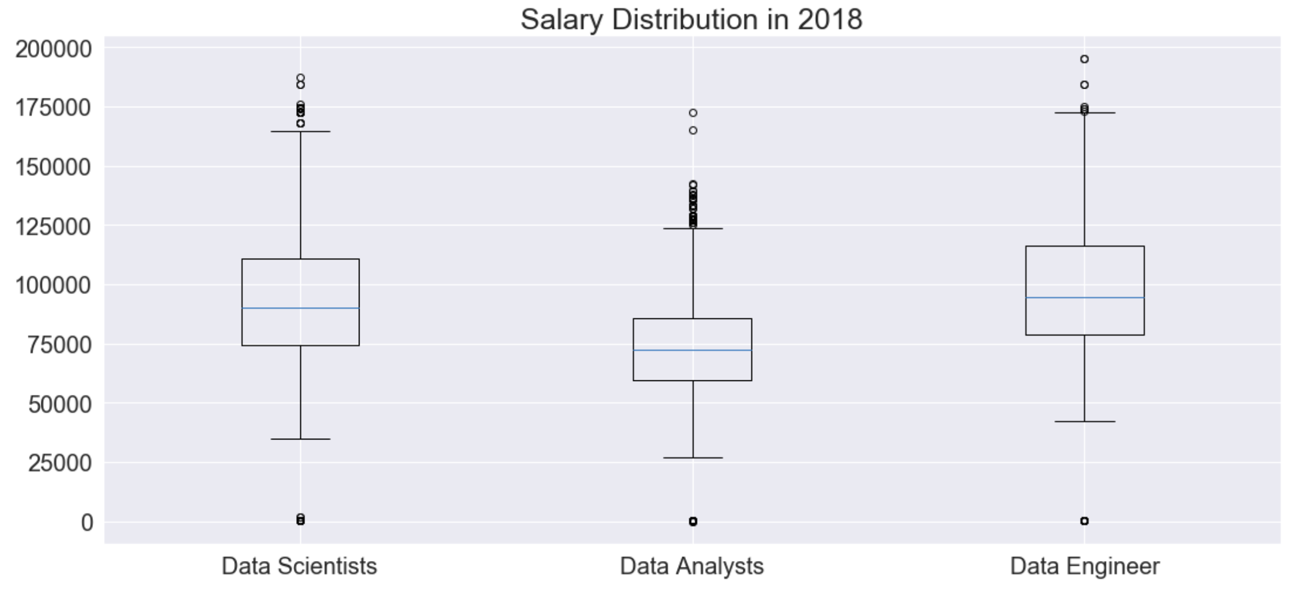
Interesting Exploritory Analysis for Data Scientists I

Slide 7
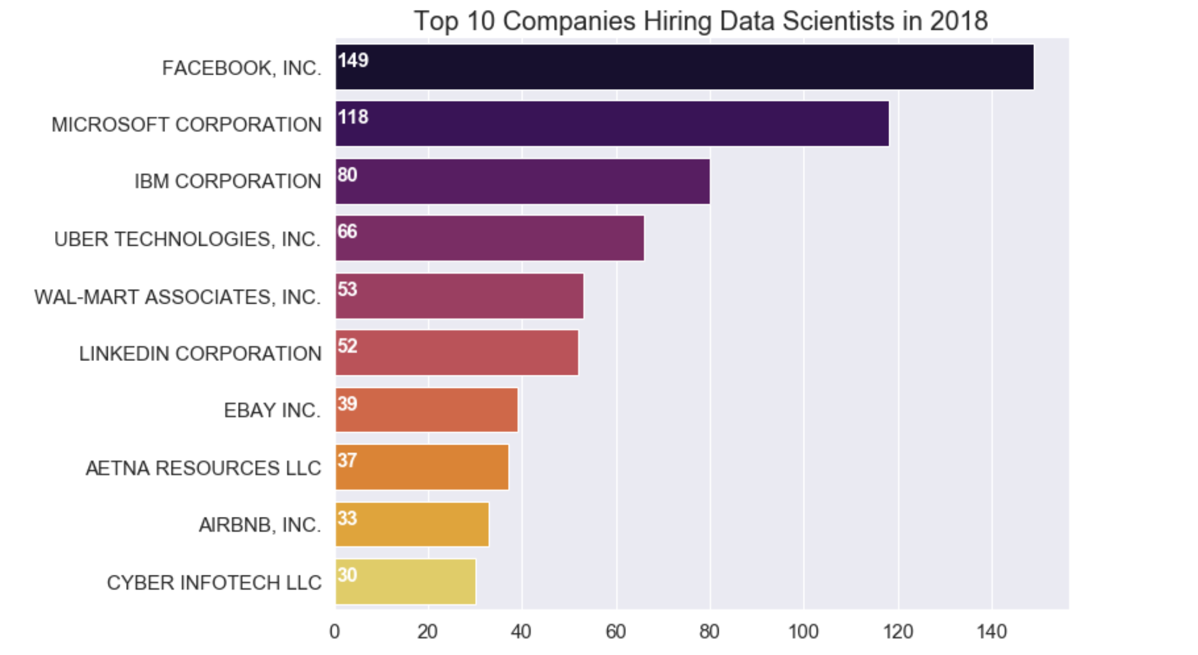
Interesting Exploritory Analysis for Data Scientists II

Slide 8
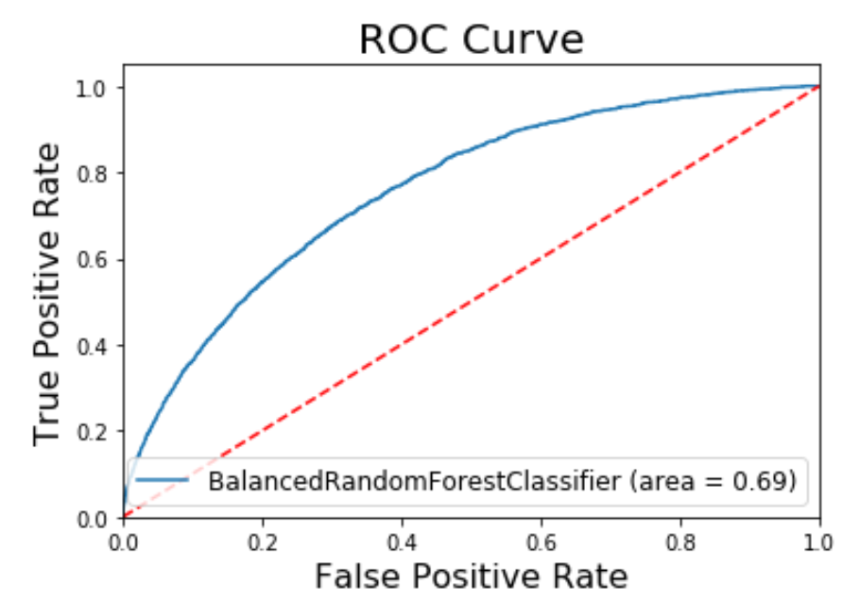
My best predictive model
From all models, Random Forest gave me the best score.
Balanced Random Forest via imblearn.
AUC = 0.69
Notes:
Imblearn is a Python package for playing with imbalanced data.
Random forest is good fit because:
I have a large dataset with many features.
I am trying to predict binary outcome
Random forest is accturate by slow on average.

Slide 9
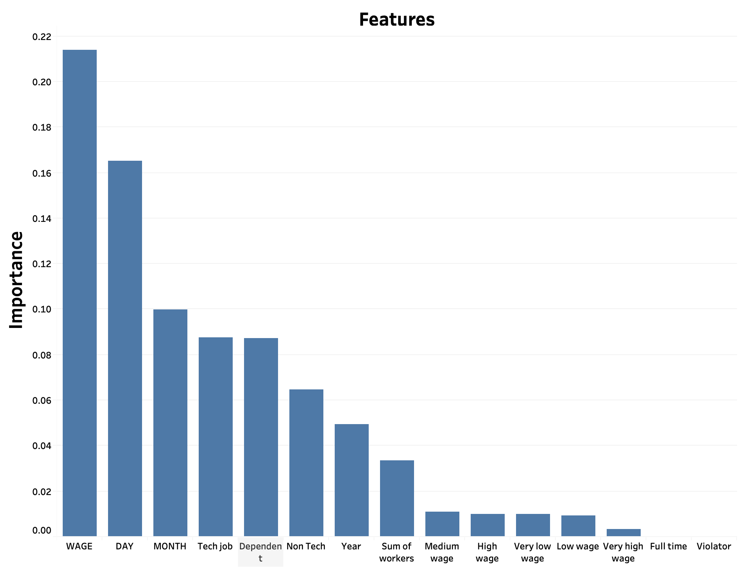
My Feature Importances I

Slide 10
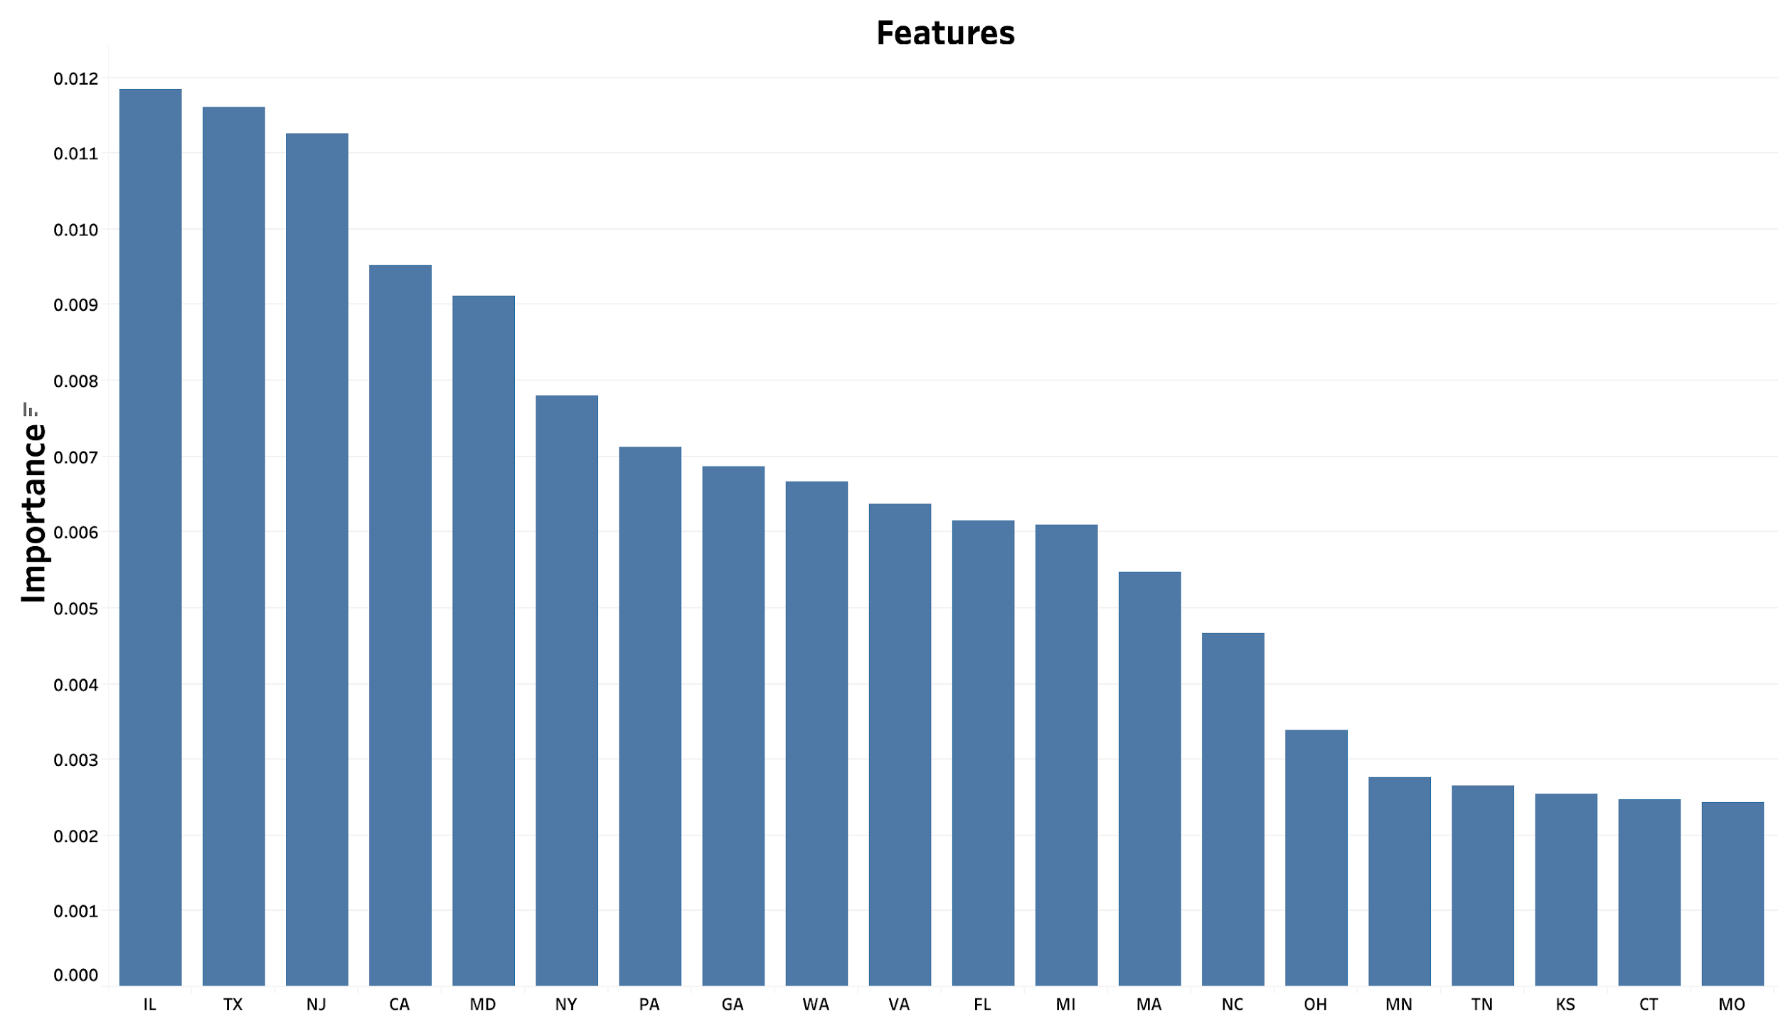
My Feature Importances II

Slide 11
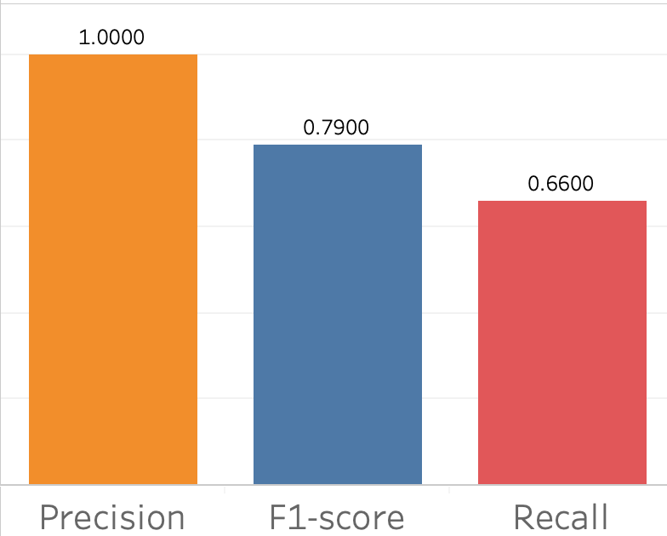
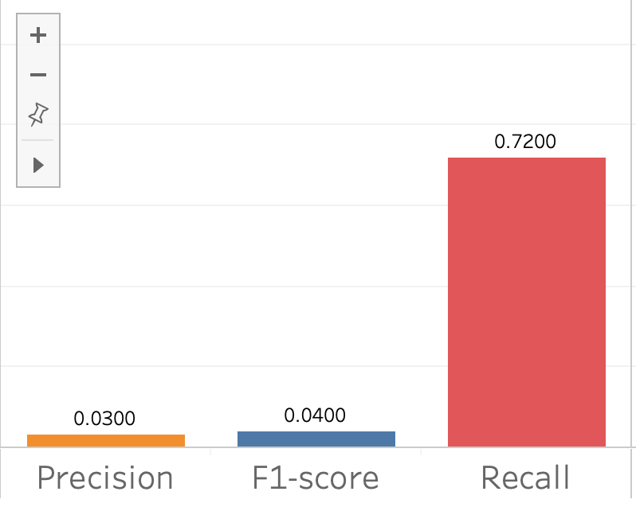
Random Forest
Case accepted Case denied
Notes:
Imblearn is a Python package for playing with imbalanced data.
Random forest is good fit because:
I have a large dataset with many features.
I am trying to predict binary outcome
Random forest is accturate by slow on average.

Slide 12
Summary
Points I need to improve my model:
Cases with denials are only 3% of my data.
I need more features on the H1B candidates like: education, work experience, country of citizenship.
My work on this project will be continued.

Slide 13

Interesting Exploritory Analysis

